Slide 1
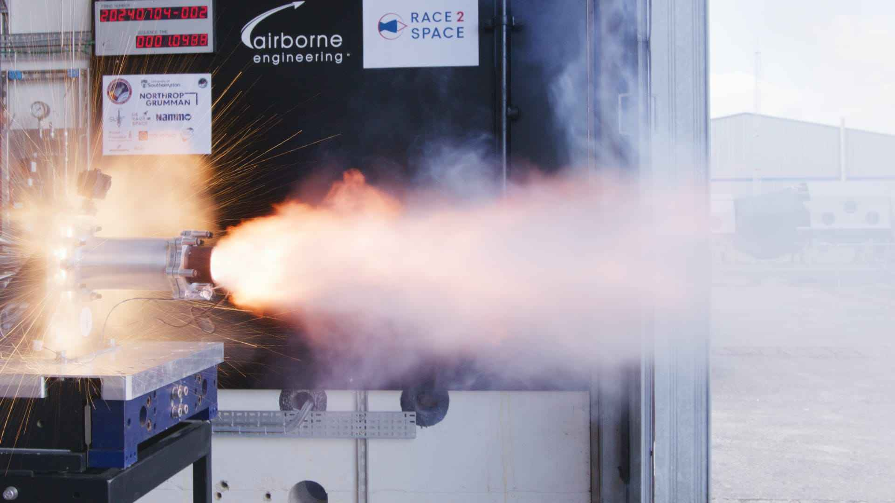
SULRE
Race to Space 2024

Slide 2
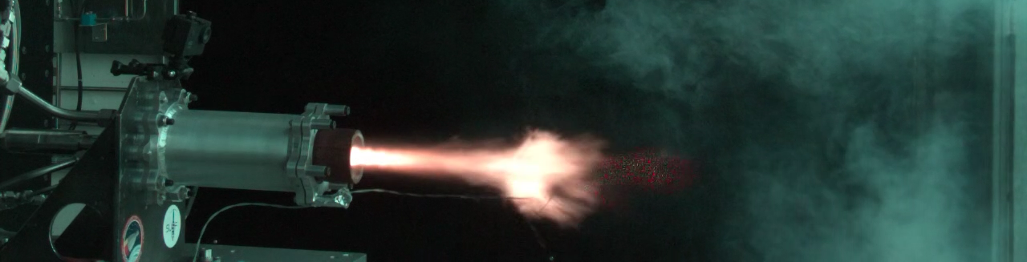
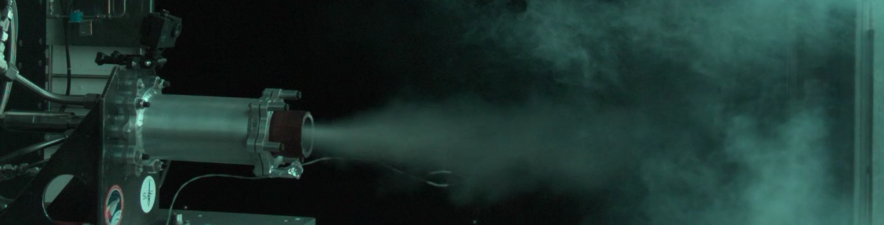
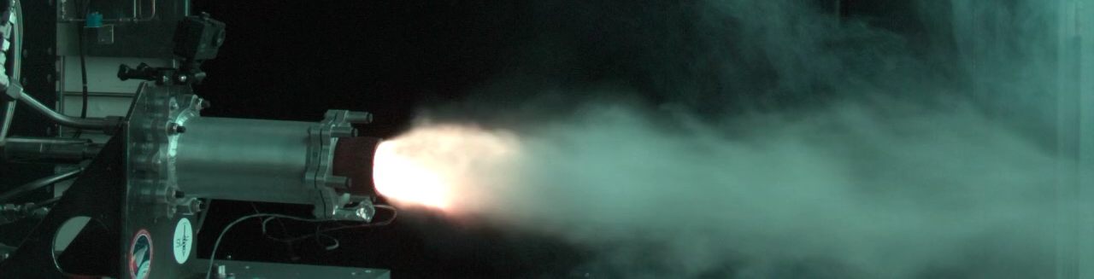
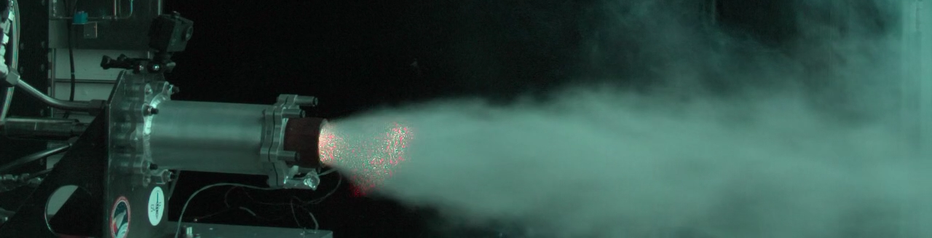
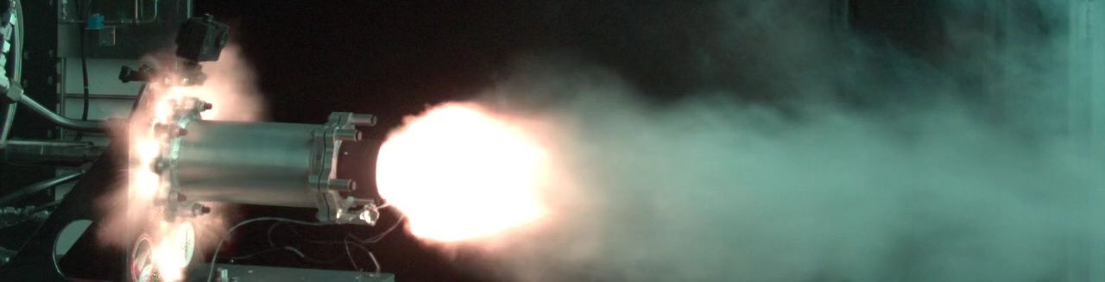
What Happened?
What we know happened:
Initially, at low feed pressures, the engine ignited.
It then extinguished itself after chamber pressure began to rise
As the fuel and oxidiser feed pressures rose, the engine would briefly ignite and extinguish
Pressure spikes rose until a catastrophic explosion occurred within the propellant manifold on the ninth spike
x8

Slide 3
Observations and Theories

